Slide 1

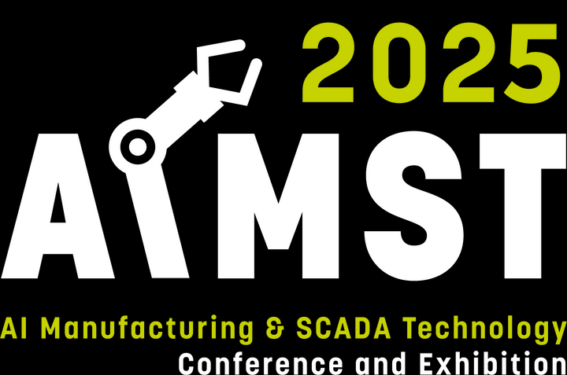
Pittsburgh, PA August 25-27, 2025

Slide 2
Pittsburgh, PA August 25-27, 2025

Slide 3
Pittsburgh, PA August 25-27, 2025

Slide 4

Pittsburgh, PA August 14-15, 2024
Pittsburgh, PA August 25-27, 2025

Slide 5
Pittsburgh, PA August 25-27, 2025

